Slide 1

PARKINSONS DISEASE DETECTION

Slide 2
Parkinson
What is Parkinson Parkinson’s disease is a complex neurodegenerative disease that affects a large portion of the worldwide population. With current prevalence rates, ranging from 10 to 800 people per 100,000, PD is one of the most common neurodegenerative disorders.
What is the Problem? There is currently no objective method for diagnosing PD. It can take months to get a reliable PD diagnosis, and symptoms need to be carefully monitored. Even then the probability of an inaccurate diagnosis is approximately 25%.
What do we do? We used the bio medical voice measurements of 31 people.The results confirmed that voice measurements is relevant in diagnosing and monitoring PD.

Slide 3
Dataset Description
The data set is obtained from uci repository. The data set consists of biomedical voice measurement of 31 people, 23 out of these 31 have PD, and the total recordings of these 31 people are represented as 195 rows. The original data set consists of 24 attributes. The 1st attributes is the name of the patient and the 18th attribute is the status of the patient which s 0 for a healthy patient and 1 for a patient with Parkinson’s disease. The other attributes are the voice measures based on these voice measures the actually classification would take place. These include different types of fundamental frequencies, Jitter, shimmer, ratio of noise to tonal components, scaling components, and fundamental frequency measurements.
The data is passed over the data preprocessing phases e.g. data cleaning, recovering missing values and transformed before applying four classification algorithms.

Slide 4
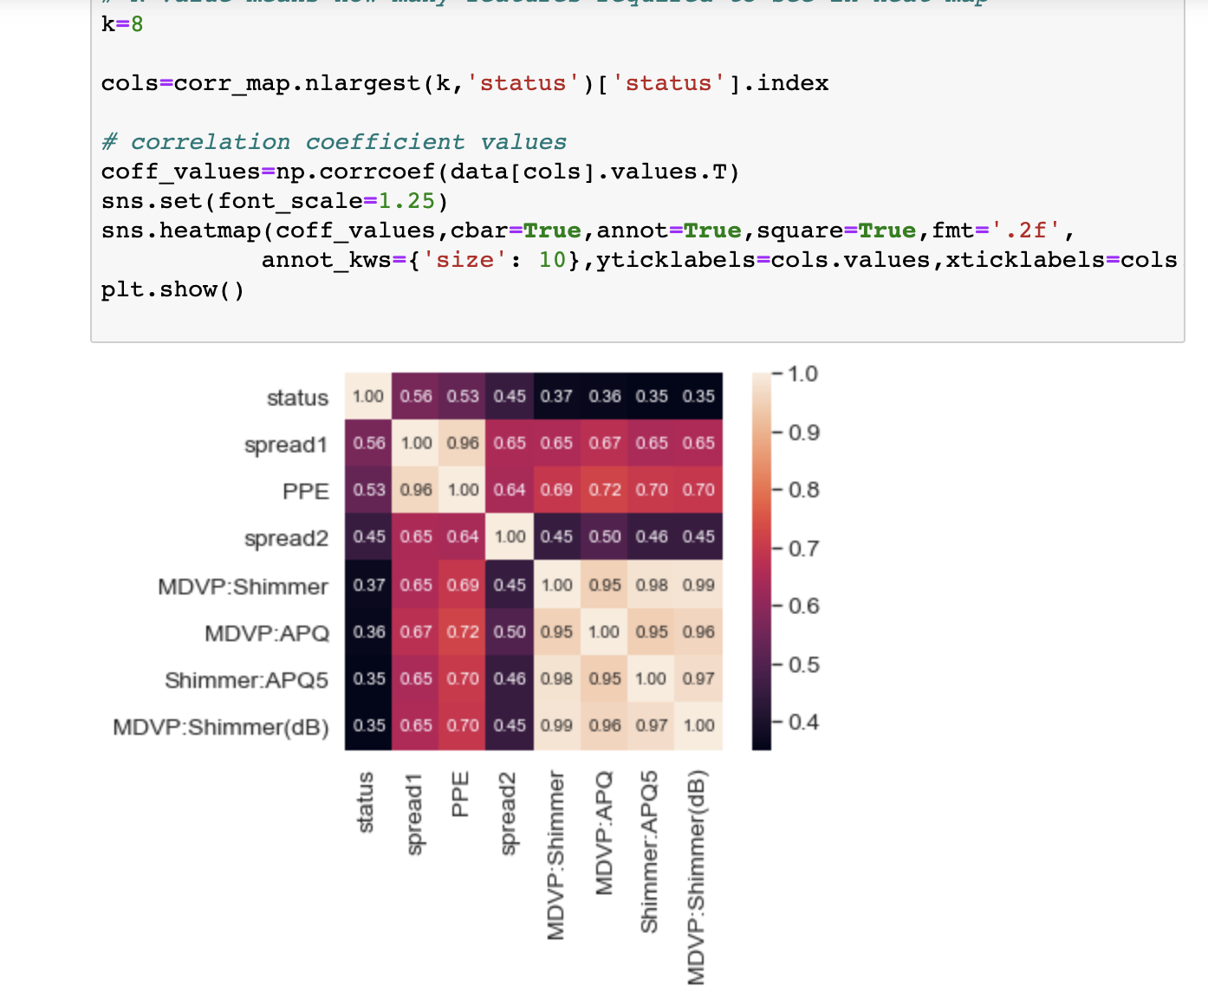
Visualising descriptive statistics
Histogram plot visualisation for each attribute will be so diffcult because we have high dimensional column. So Better, we can use heat map to find the correlations coefficient values and we can remove the irrelavant features it will minimize the accuracy of an algorithm.
we have correaltion values in each attribute in descending order so we are going to drop from MDVP:RAP column to MDVP:Fhi(Hz) because it have less correlation with other columns.
In the target column, there are 48 healthy people & 147 people with Parkinson's disease . 'name' is object and also it doesn't contribute in model building so it has to be removed from dataset by using hnr and nhr . We also find the relation between them using corelation plot to find the corelation between them and we drop the less corelated values

Slide 5
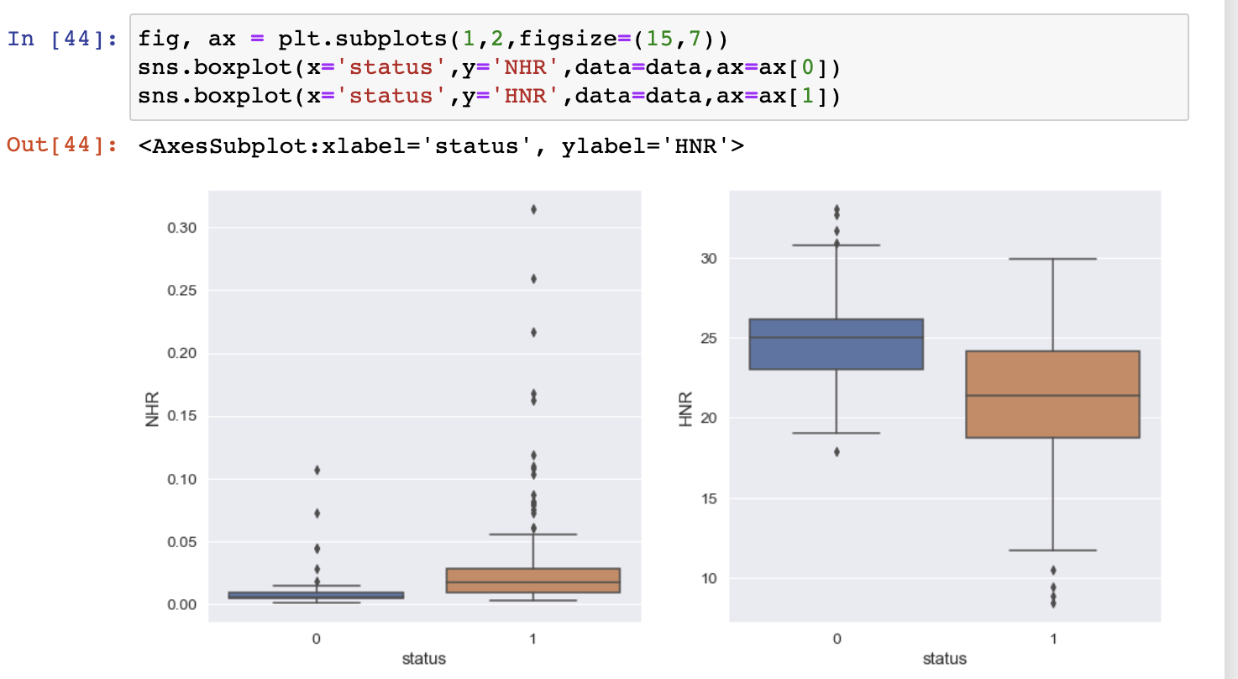
People who have PD(status equal to one) have higher levels of outliers. Also, looking into the HNR ratio people who have PD have lower levels in the same. Noise to Harmonic Ratio (NHR) is another useful measure . This can be routinely measured using MDVP. For a signal that can be assumed to be periodic (vowels), the signal-to-noise ratio will be equal to the harmonics-to-noise ratio (HNR)

Slide 6
Classifier Used and result
Splitting data into training and testing set
Classification model without applying feature scaling
Classification model with applying feature scaling
Regularisation tuning for top 2 classification algorithms
Ensemble and boosting classifaction algorithms with feature scale.
Regularisation Tuning For Top 2 Ensemble and Boosting Classification Algorithms.
Compare All 4 Tunned Algorithms And Selecting The Best Algorithm

Slide 7
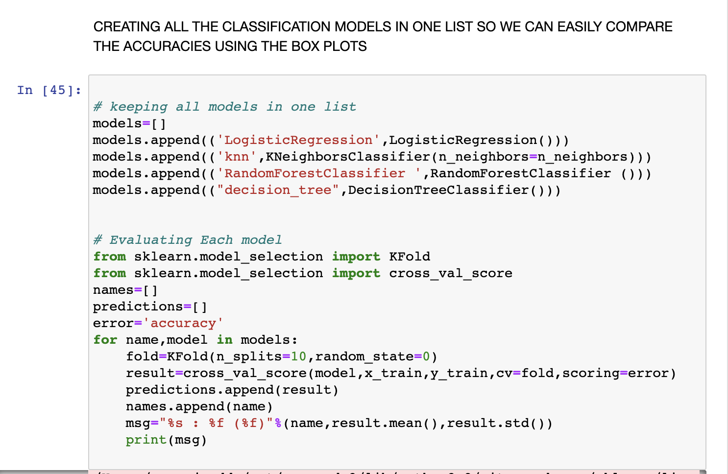
CLASSIFICATION MODELS WITHOUT APPYING FEATURE SCALING
TTTTTTTT THE ACCURACIES ARE:
LOGISTIC REGRESSION | 0.860440 (0.089956)
KNN | 0.808242 (0.119180)
RANDOM CLASSIFIER | 0.897802 (0.046115)
DECISION TREE | 0.852198 (0.048117)

Slide 8
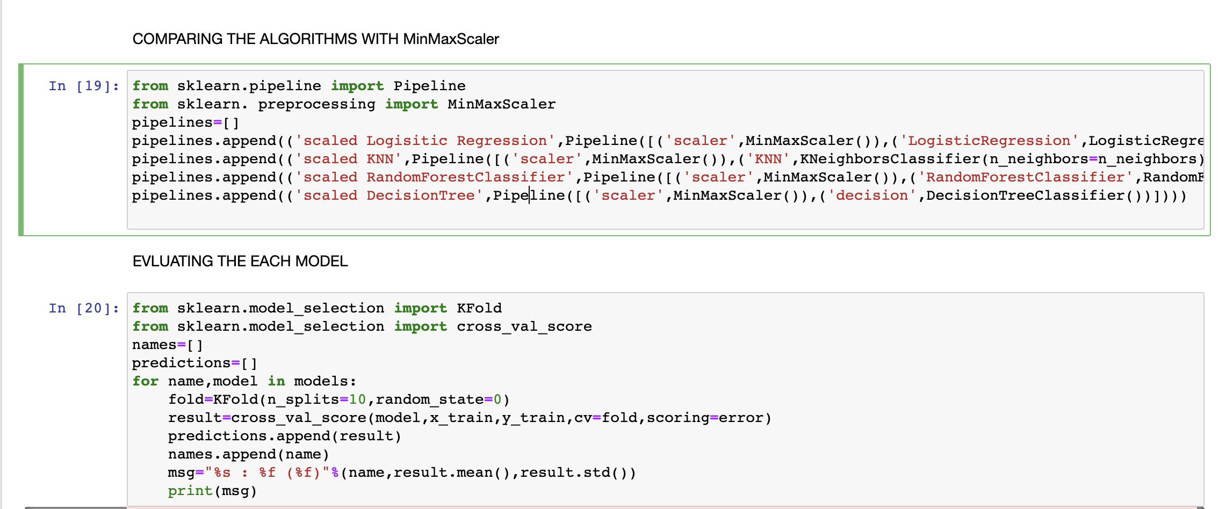
CLASSIFICATION MODELS WITH APPLYING FEATURE SCALING
LOGISTIC REGRESSION | 0.860440 (0.089956)
KNN | 0.808242 (0.119180)
RANDOM FOREST CLASSIFIER | 0.912088 (0.052930)
DECISION TREE | 0.837912 (0.063330)

Slide 9
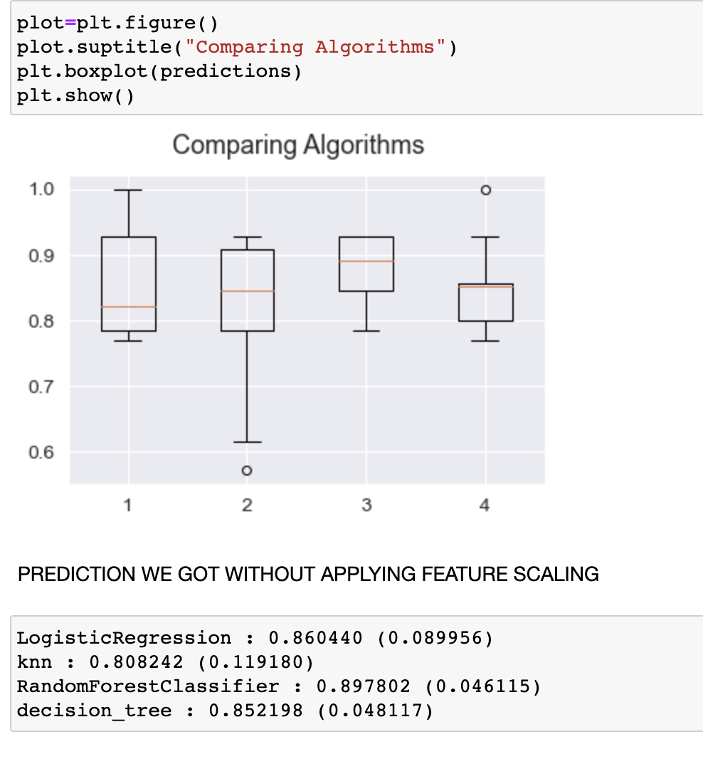
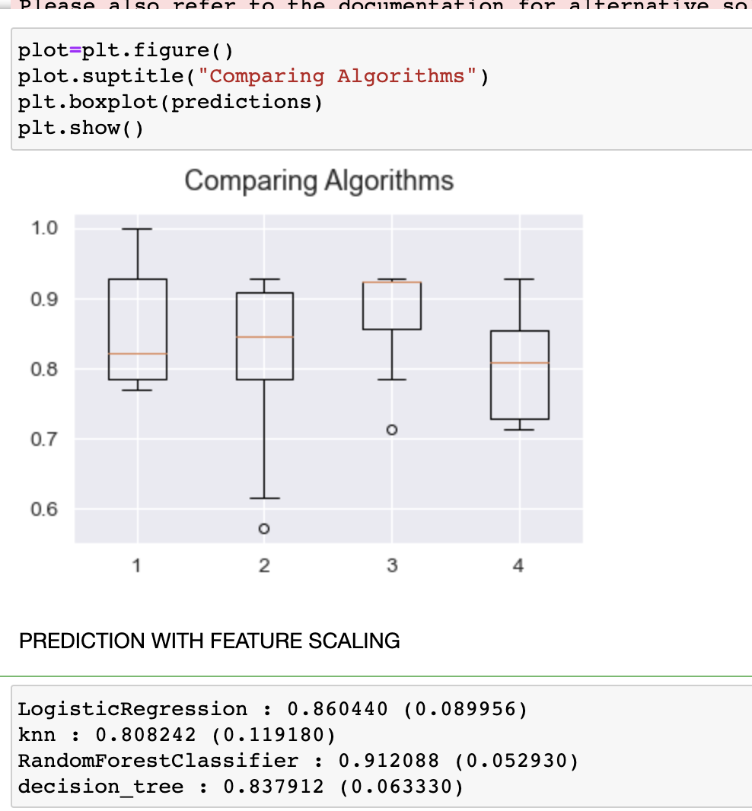
COMPARING THE ACCURACIES
Random forest classifier perfoms well in both the predictions

Slide 10
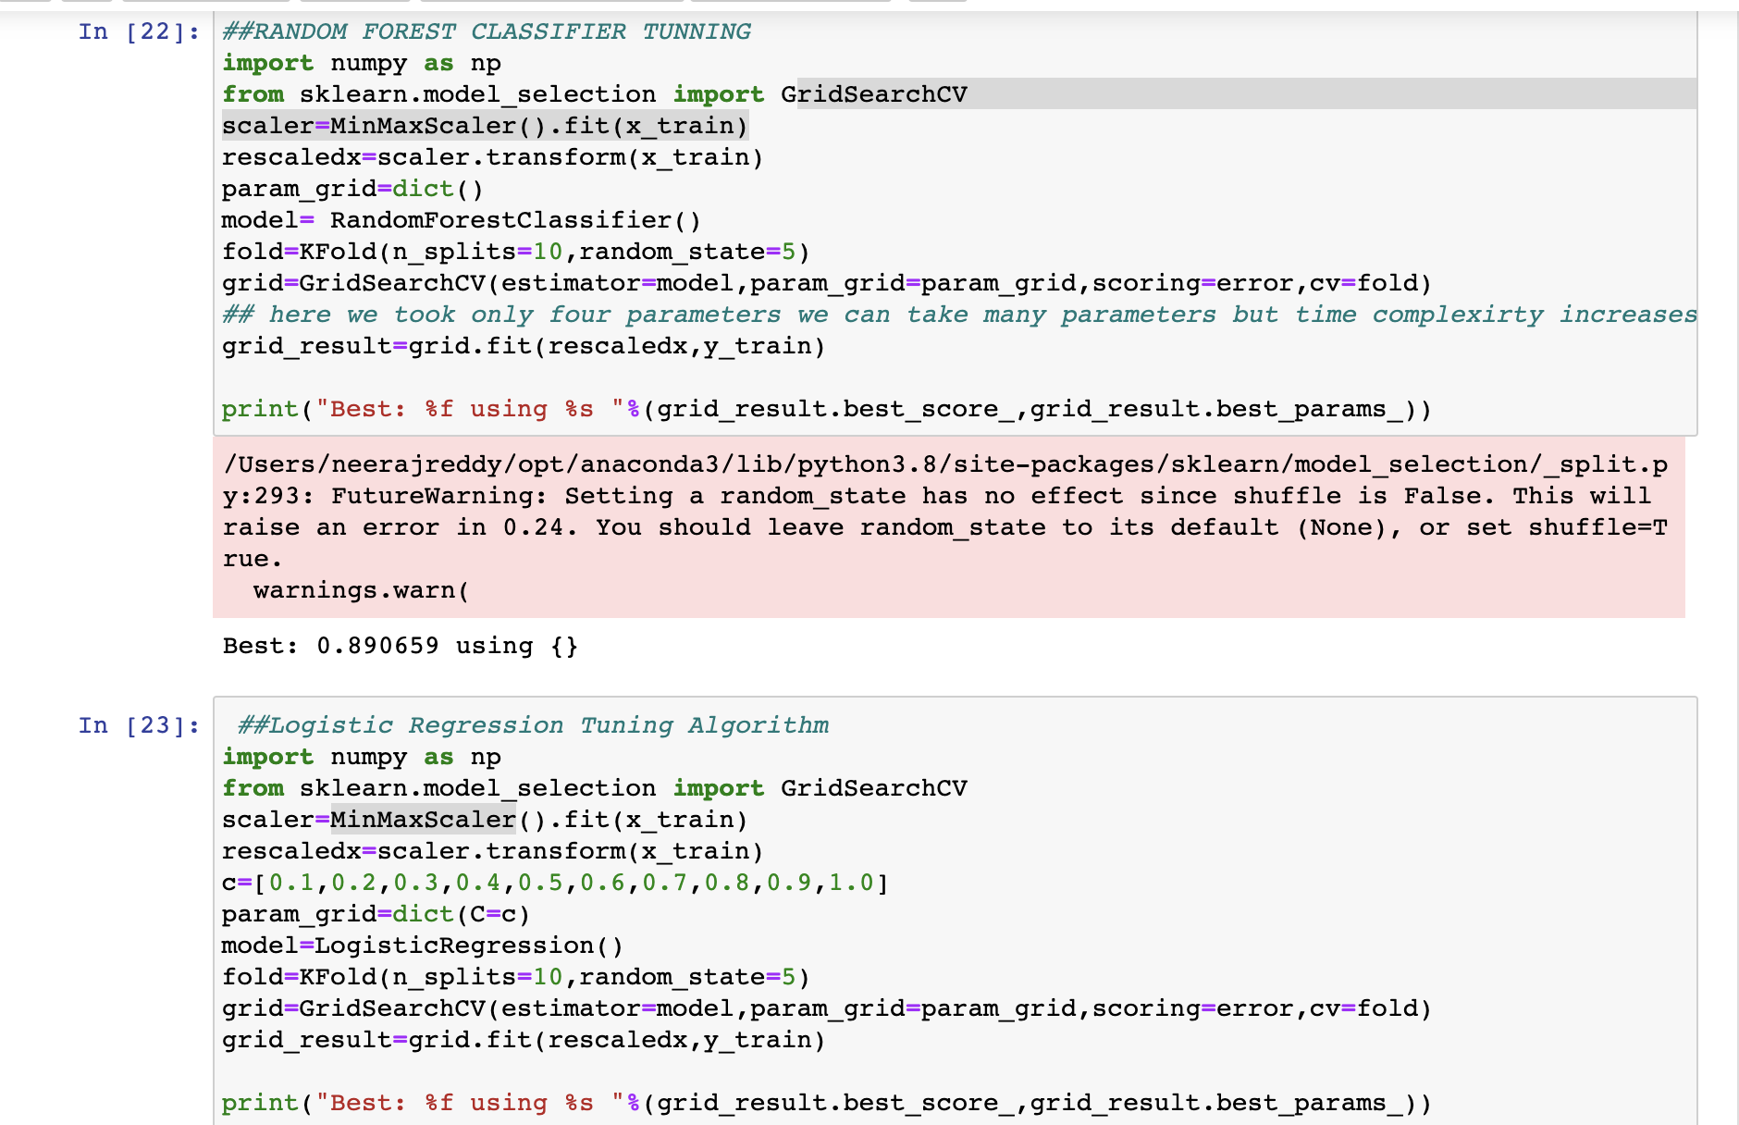
TUNING FOR TOP 2 ALGORITHMS(NOTHING BUT CHANGING PARAMETERS)
RANDOM FOREST | 0.890659 using {}
LOGISTIC REGRESSION | 86.15 using {'C': 0.4}

Slide 11
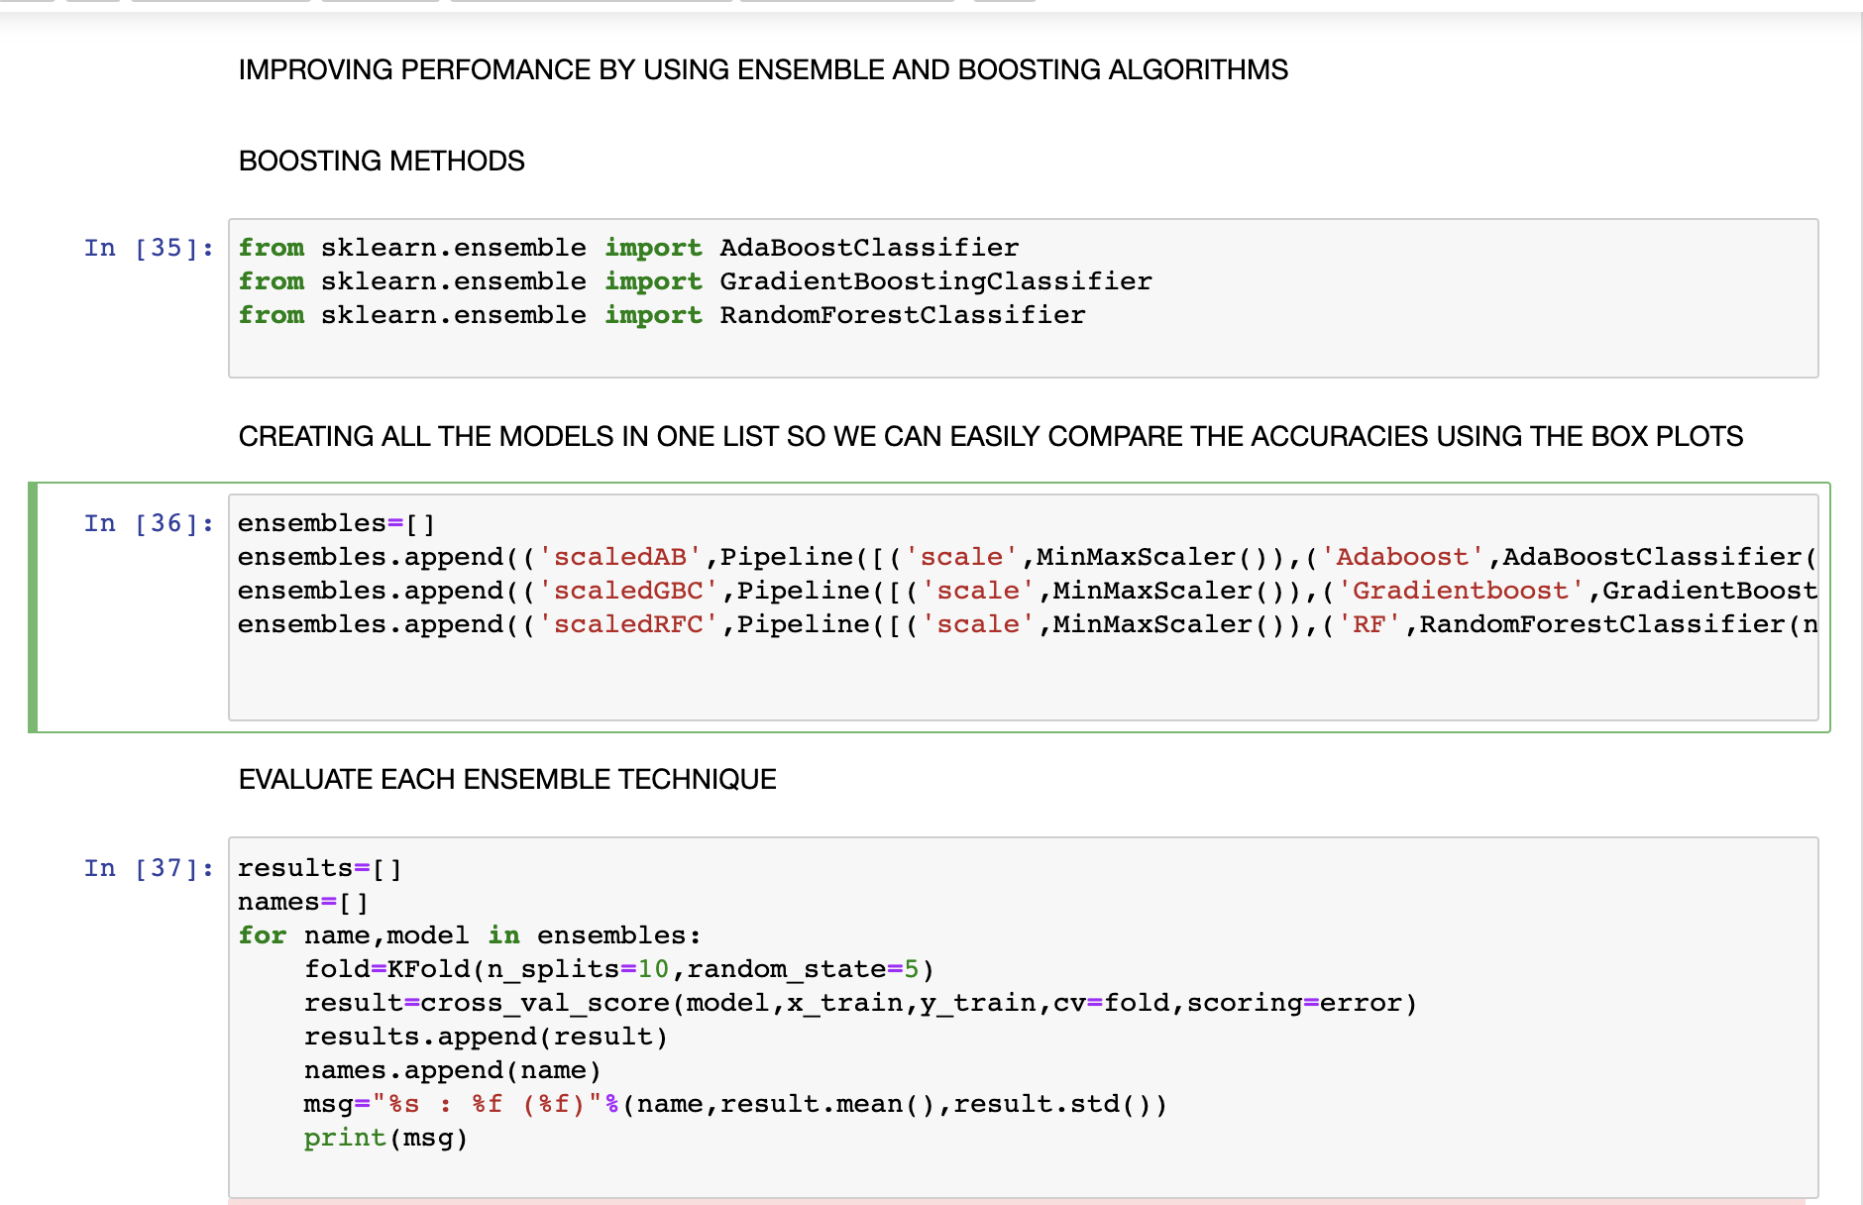
IMPROVING PERFOMANCE BY USING ENSEMBLE AND BOOSTING ALGORITHMS
ADA BOOST | 0.839560 (0.081896)
GRADIENT BOOSTING | 0.867582 (0.070383)
RANDOM FOREST | 0.912088 (0.065852)

Slide 12
Compare All 4 Tunned Algorithms And Selecting The Best Algorithm
Gradientboostclassifier | Best: 0.897802 using {'n_estimators': 200}
Random forest classifier | Best: 0.912088 using {'learning_rate': 0.7, 'n_estimators': 100}
LogisticRegression | 0.860440 (0.089956)
decision_tree | 0.837912 (0.063330)
we got testing set accuracy of 91.20% by using random forest classifier
train set 1.0
train set matrix [[ 32 0] [ 0 104]]
test set = 0.912088
test set matrix [[11 5] [ 0 43]]

Slide 13
CONCLUSION
By data preprocessing especially irrelevant dimensions and outliers are removed. Once the data is similar to the normal distribution four methods are used to classify the data. K-NN, Random Forest, and Gradientboost ,decision tree are used. The comparative analysis shows that out of the four Random Forest is the best model for classification with accuracy of 91.20 using k=10 fold validation and 70: 30 split. The model was not underfitted or overfit it fitted perfectly.
The study uses the data mining analysis to explore the Parkinson’s Disease data. Data mining is widely used in the realm of the preventive medicine. By means of the study of the PD data, medical researchers can create the evaluation table according to the results of data mining in order to make physicians and ordinary people aware the early symptoms of PD and make earlier treatments.

